Slide 1
22MAT230 Mathematics for Computing 4
Adaptive Toeplitz Convolution
Team 17
CH. Priya Madhav - CB.SC.U4AIE24211
G.G. Rishi Kanth - CB.SC.U4AIE24218

Slide 2
INTRODUCTION
Convolution is a fundamental operation in signal processing
Traditionally implemented using sliding windows
Can also be represented using matrix operations
Toeplitz matrices provide a structured way to represent convolution

Slide 3
OBJECTIVES
To understand convolution from a mathematical perspective
To represent convolution using Toeplitz matrices
To design an adaptive convolution kernel using statistics
To perform convolution using matrix multiplication
To reduce dimensionality using pooling

Slide 4
METHODOLOGY
Take a discrete time-series signal 𝑥
Compute mean (𝜇) and standard deviation (𝜎)
Construct adaptive kernel ‘𝐾’ Build Toeplitz matrix ‘𝑇’ from signal
Perform matrix multiplication
Apply pooling for simplification

Slide 5
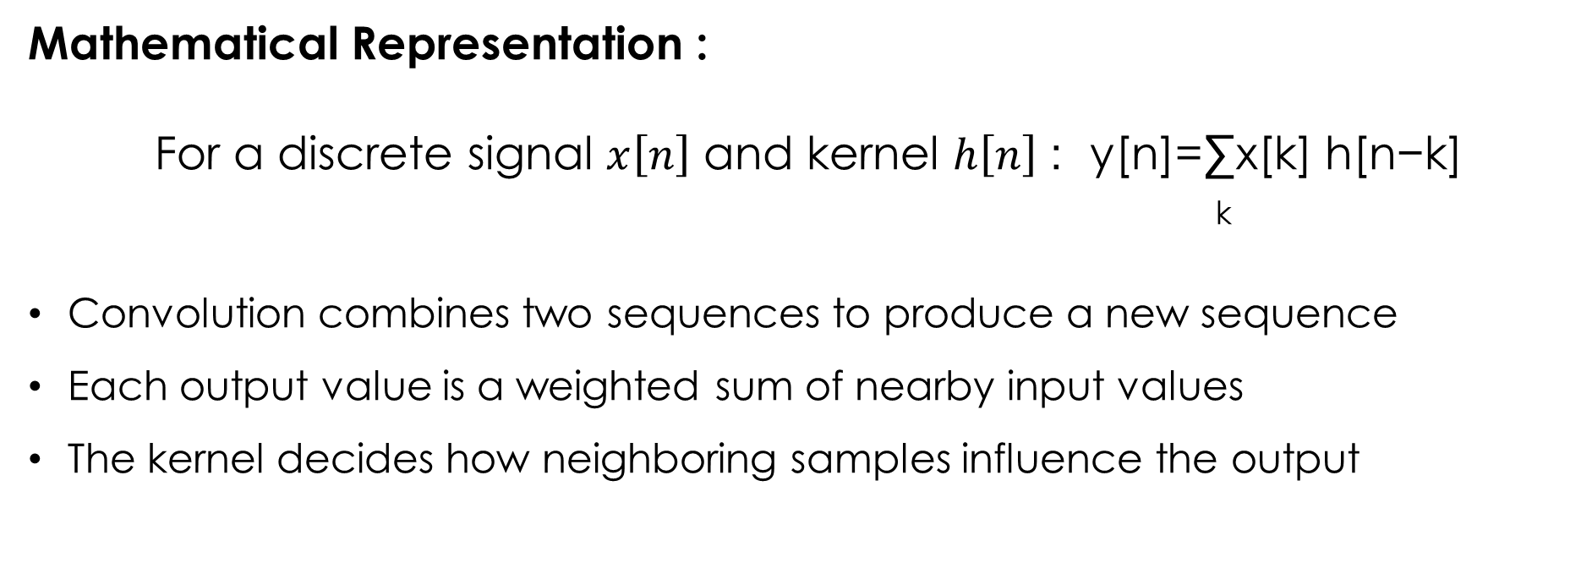
CONVOLUTION
Mathematical Representation :
For a discrete signal $x\left[n\right]$ and kernel $h\left[n\right]$ : y[n]=∑​x[k] h[n−k]
k
Convolution combines two sequences to produce a new sequence
Each output value is a weighted sum of nearby input values
The kernel decides how neighboring samples influence the output

Slide 6
ADAPTIVE KERNEL
Kernel : K=[μ−2σ, μ, μ+2σ]
Instead of choosing a fixed kernel, we generate a kernel from the signal itself
The kernel captures low, central, and high values of the signal
Kernel values change when the signal changes
The mean represents the average value of the signal
Standard deviation measures how much the signal varies around the mean

Slide 7
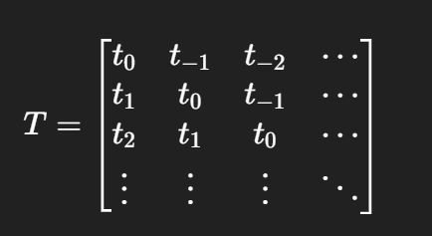
TOEPLITZ MATRIX
Toeplitz Matrix Form :
A Toeplitz matrix has constant values along each diagonal
It represents time-shifted versions of a signal
Each row corresponds to a shifted version of the signal
This structure naturally models convolution

Slide 8
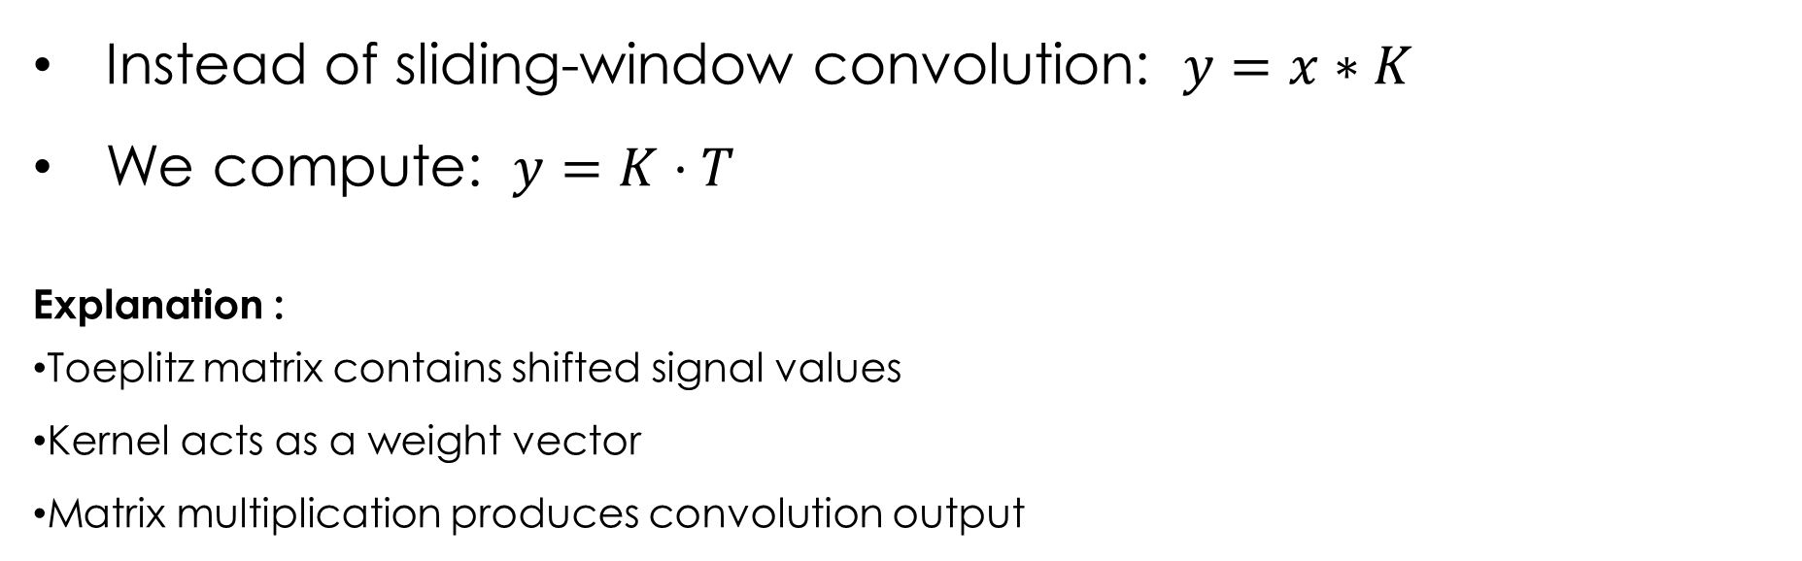
Convolution as Matrix Multiplication
Instead of sliding-window convolution: $y=x∗K$
We compute: $y=K⋅T$
Explanation :
Toeplitz matrix contains shifted signal values
Kernel acts as a weight vector
Matrix multiplication produces convolution output

Slide 9
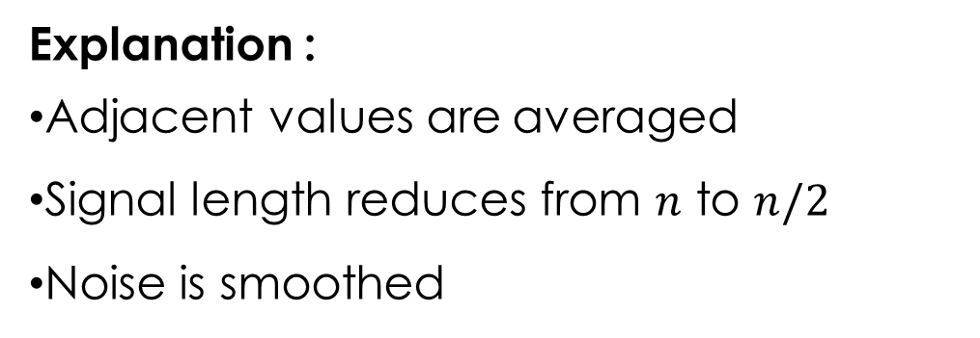

POOLING
Convolution output may be large
Pooling reduces size while preserving structure
Average Pooling :
$$y_{p}\left(i\right)=\frac{y\left(2i−1\right)+y\left(2i\right)}{2}$$
Explanation :
Adjacent values are averaged
Signal length reduces from $n$ to $n/2$
Noise is smoothed

Slide 10
Future Scope
The adaptive Toeplitz convolution approach can be extended using larger or variable kernel sizes to capture more complex signal patterns.
The method can be applied to multidimensional or real-world time-series data to analyze its mathematical behavior.
This matrix-based formulation can be further integrated with classification or detection frameworks beyond the current mathematical scope.

Slide 11
THANK YOU

